Slide 1
Public Sentiment And Canadian Housing
Abdul & Uzair
Notes:
Briefly mention the team composition and the title of your project.

Slide 2
Research Question
“What is the opinion of social media users regarding housing costs in
Canada?”
Notes:
State what your research question is and explain why it is important to study. Slide 1: Research Question
“What is the opinion of social media users regarding housing costs in Canada?”
Slide 2: Importance of the Study
Relevance: With home prices up by more than 35% in just four years, housing affordability is a significant issue affecting a large portion of the Canadian population.
Public Sentiment: Understanding public sentiment towards housing costs in Canada can provide valuable insights into the lived experiences of Canadians.
Policy Decisions: The findings from this research could potentially inform policy decisions and stimulate further academic discussions on this topic.

Slide 3
Data & Methods
01
02
03
04
05
Data Source
Collection Time
Sentiment Analysis
Collected From 2 Subreddits
Top Newest Posts Within The Year
Analyzed Subreddit Sentiment of Posts
Topic Modelling
Visualizations
Preprocessed Text & Used LDA Model
Used Various Graphs To Show Findings
Notes:
Question:
Data and methods slide – 20 seconds
Briefly talk about where your data is coming from (e.g. you scrapped 5000 comments from a Reddit community)
What methods did you use?
Our Answer:
Data Source: We collected data from two subreddits: CanadaHousing and Canada using the Python Reddit API Wrapper (PRAW). The top 100 posts from each subreddit were fetched for the analysis.
Data Collection Time: The data was collected over a span of three days from March 28-30, ensuring that the analysis is based on the most recent and relevant posts.
Method 1 - Sentiment Analysis: We analyzed the overall sentiment of the posts in these subreddits. This involved generating a word cloud to understand key terms and phrases, and using a sentiment intensity analyzer to categorize the sentiments.
Method 2 - Topic Modeling: We performed topic modeling on the posts. This involved preprocessing the text content of the posts and using the Latent Dirichlet Allocation (LDA) model to identify hidden topics in the text.
Visualizations: We used various visualizations to showcase our findings, including word clouds, scatterplots, bar plots, and pyLDAvis for an interactive visualization of the topics.

Slide 4
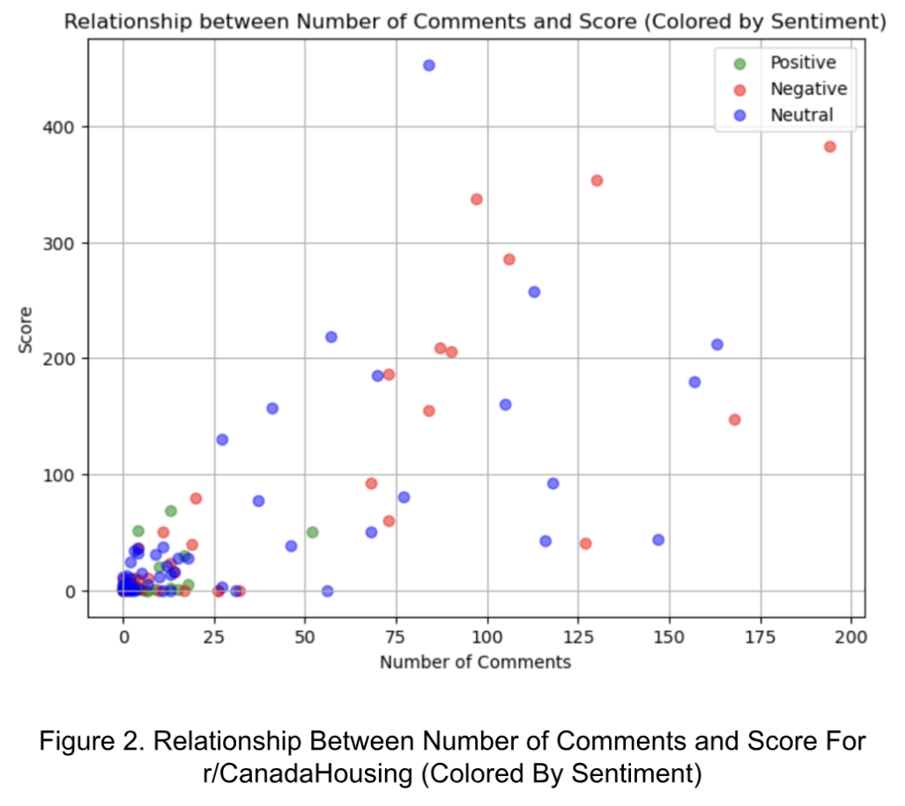
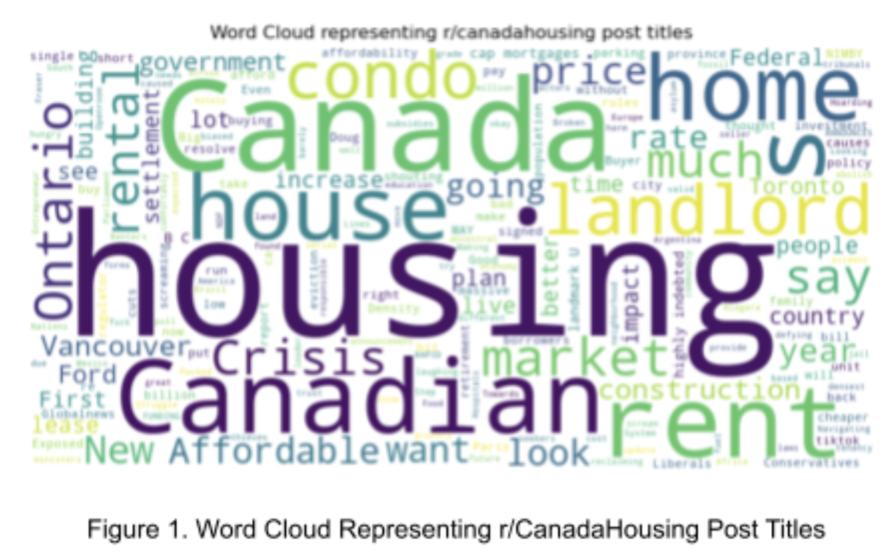
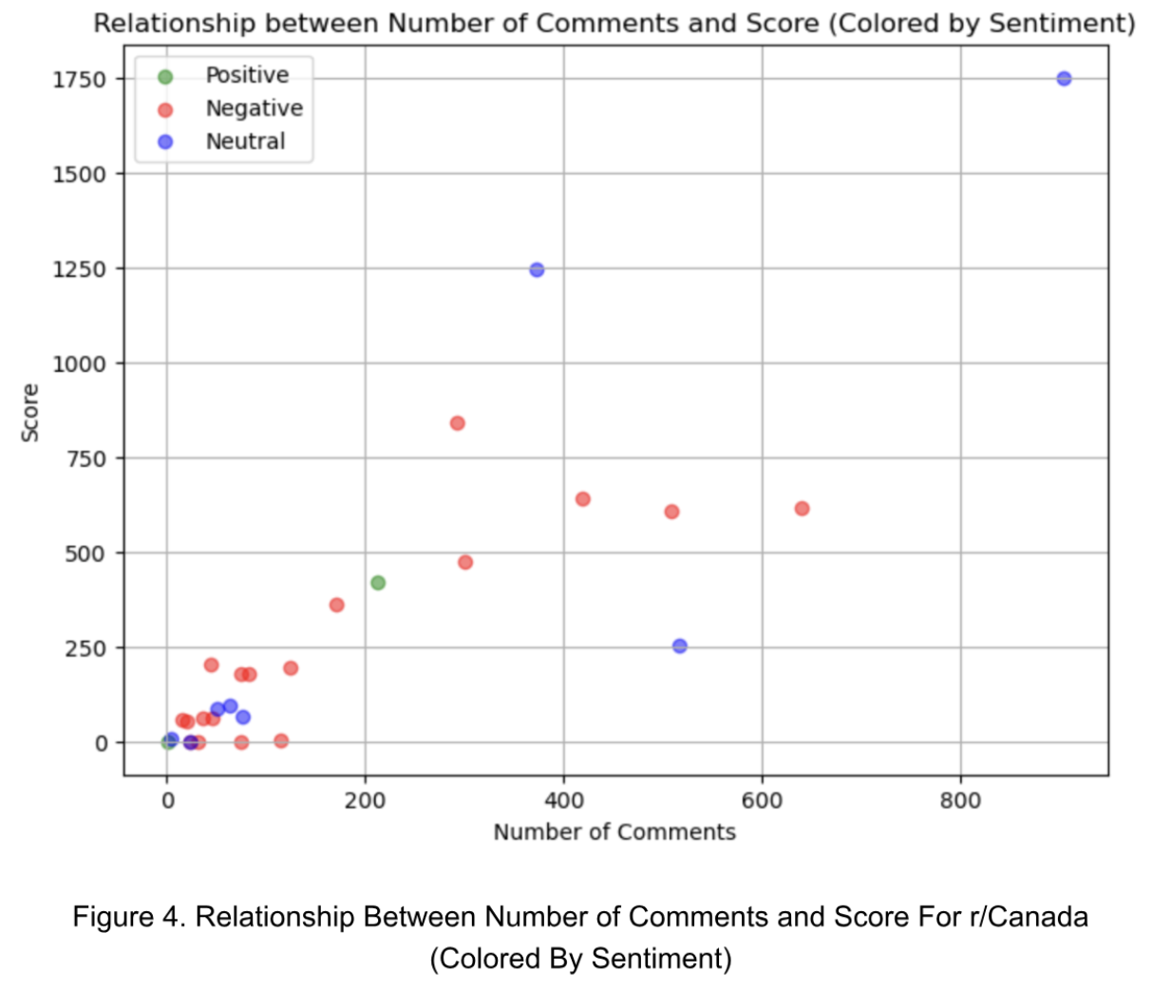
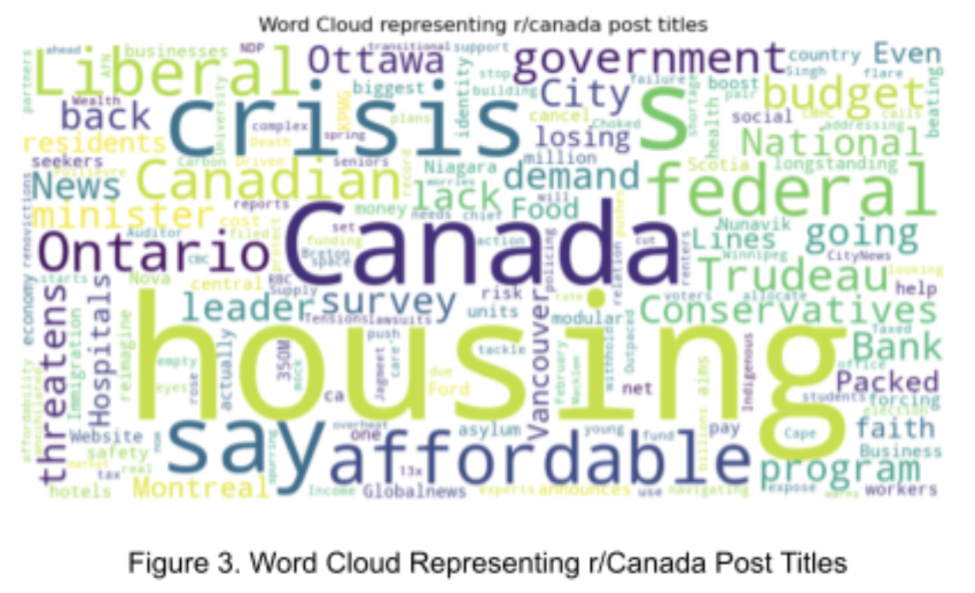
Results From Sentiment Analysis
Notes:
Results (2-3 slides) – 1 min and 20 seconds
Tell us the most important results!
What is the answer to the question you posed initially?
Tip: make sure you use quality visualizations rather than a lot of text. Illustrate your points with quotes from source materials.
Answer:
The word clouds for both r/CanadaHousing and r/Canada subreddits show a strong focus on housing issues, with frequent discussions on topics like “housing”, “house”, “condo”, “crisis”, “affordable”, and “market”. This indicates concerns about housing affordability and market conditions in Canada.
The sentiment analysis reveals a predominantly negative tone in both subreddits. In r/CanadaHousing, less than 10% of posts were positive. In r/Canada, despite a larger volume of posts, the sentiment remained largely negative, suggesting deep concerns about the Canadian housing issue.
The r/Canada subreddit showed higher engagement in terms of comments and scores, indicating that each post garners more attention and interaction.

Slide 5
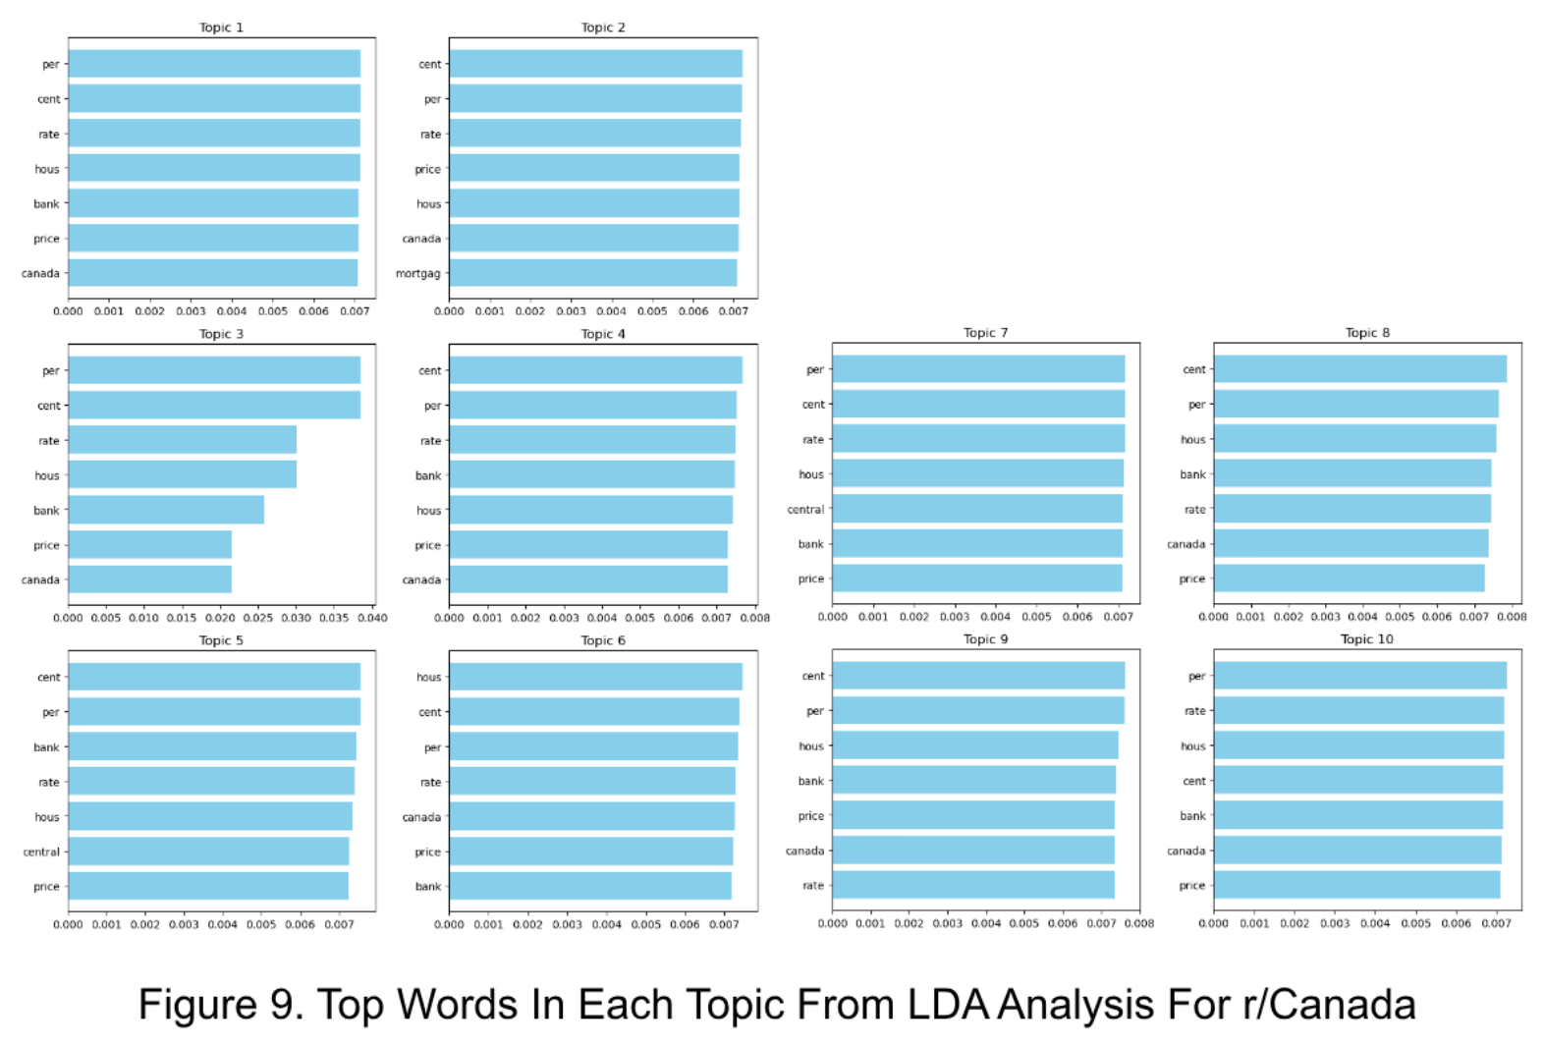
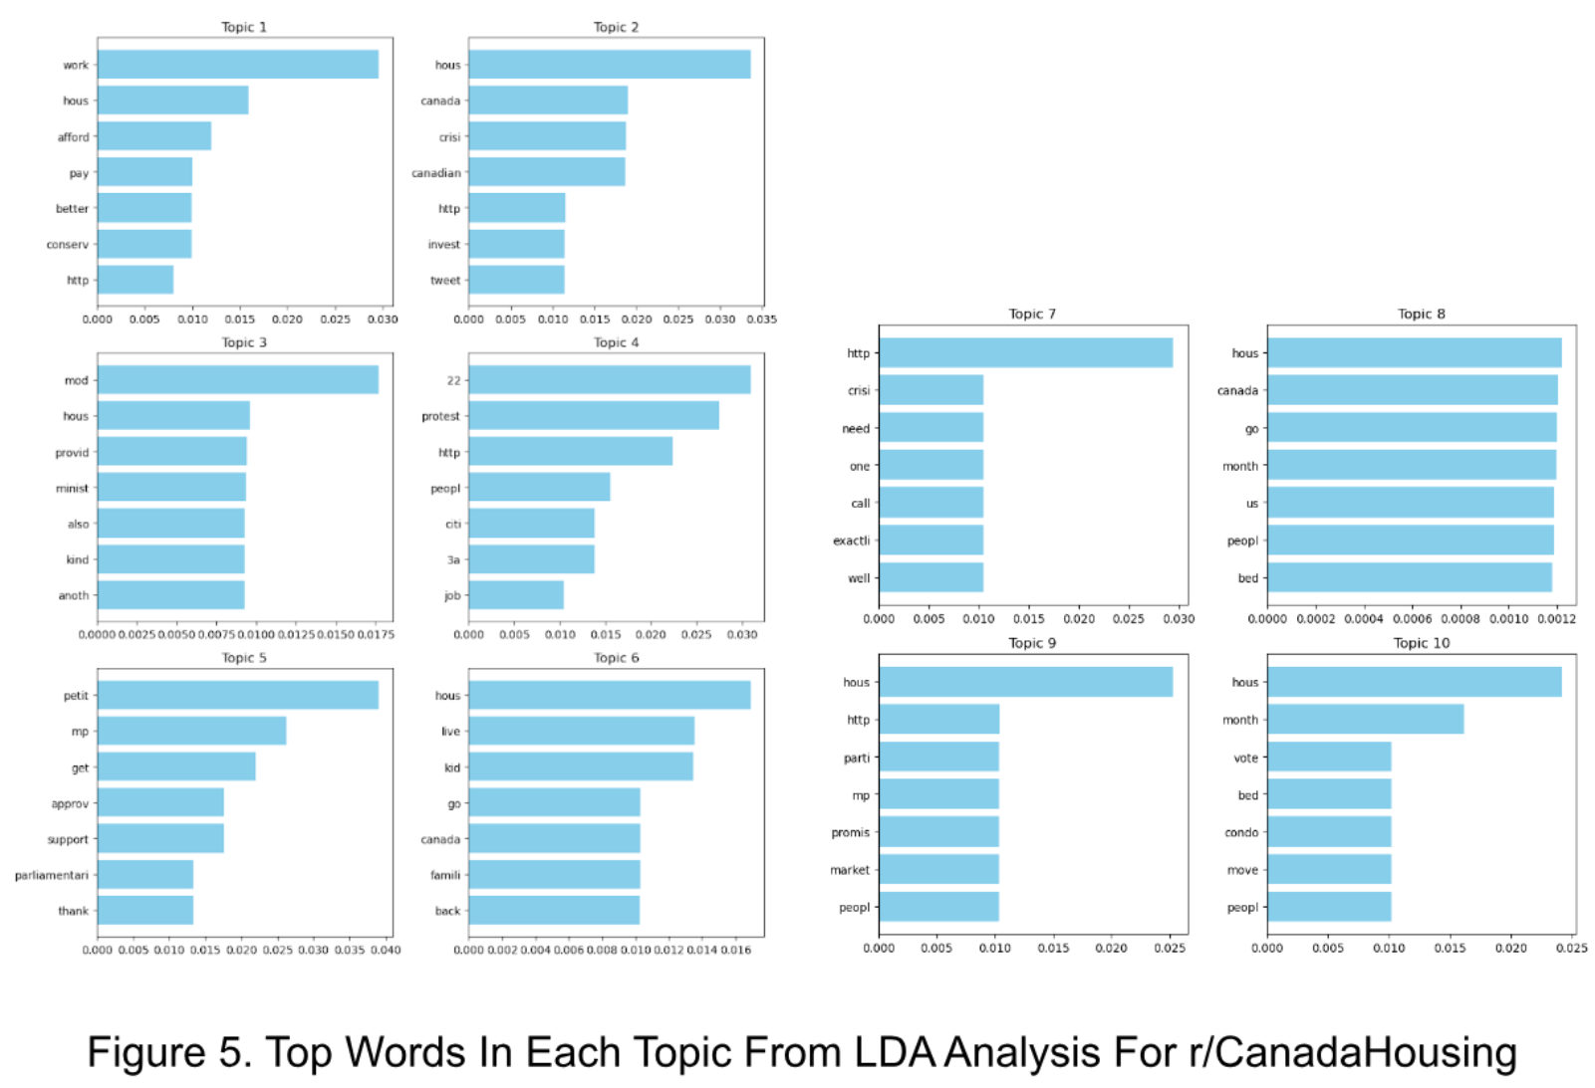
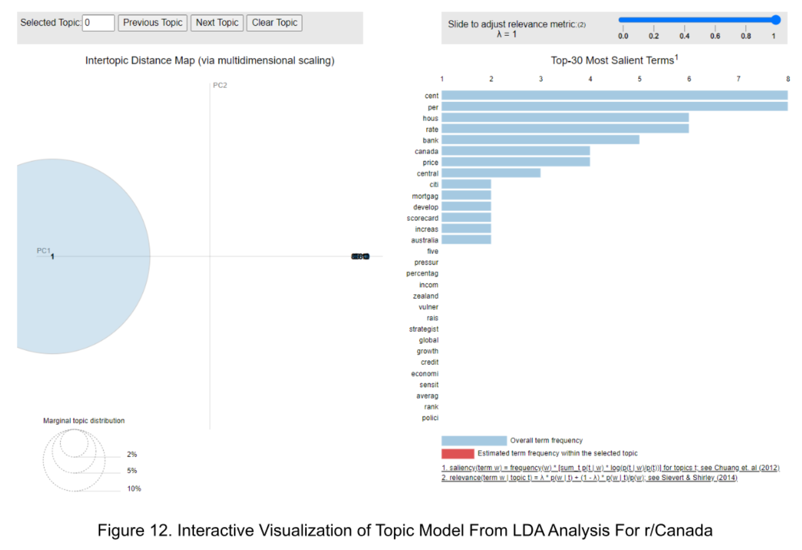
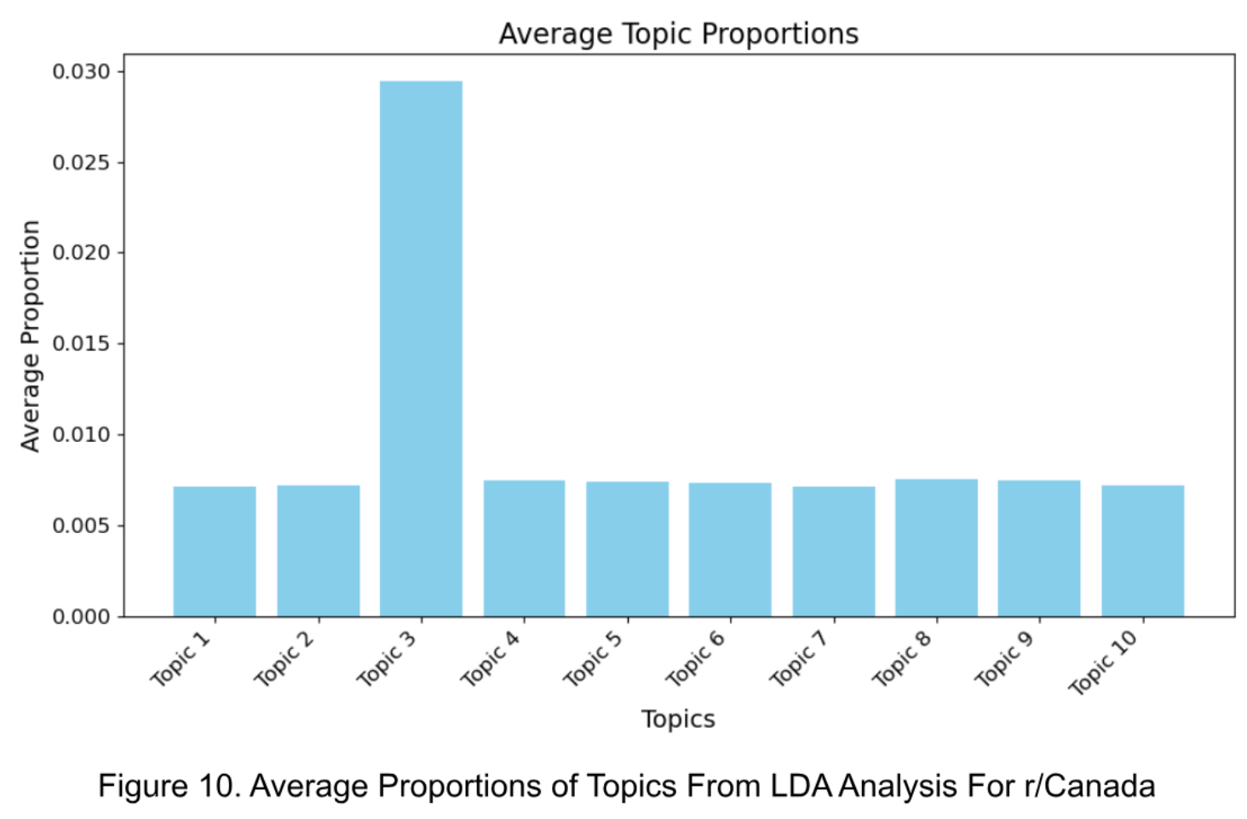
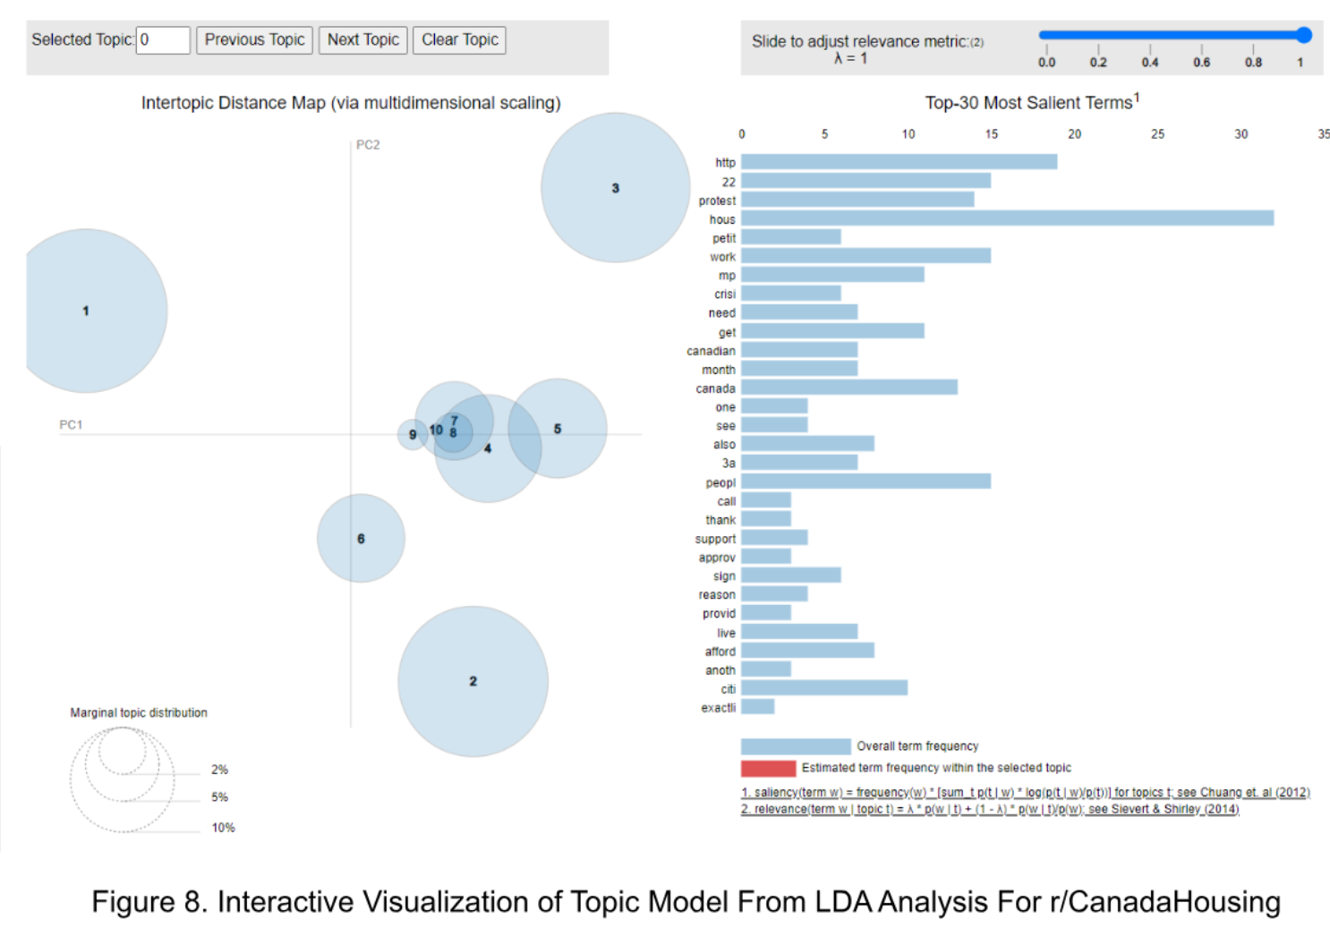
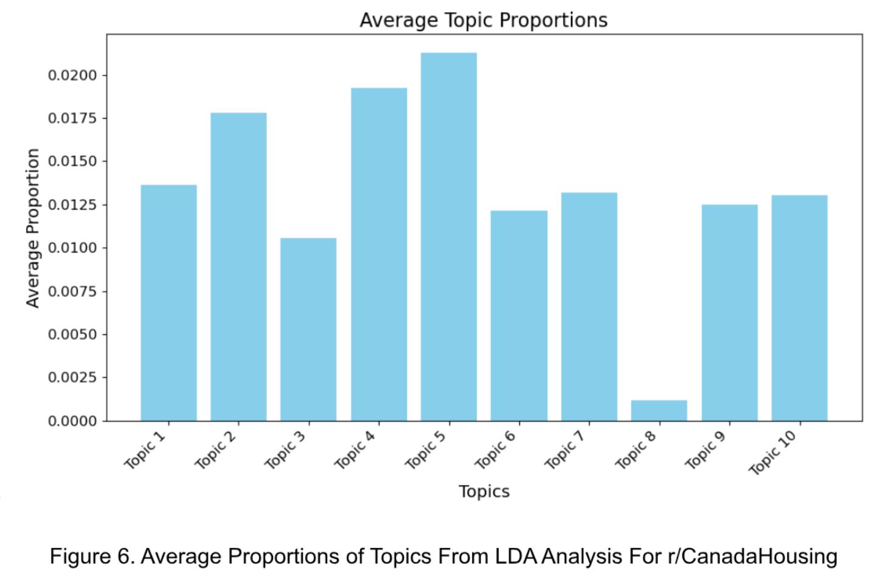
Results From Topic Modelling
Notes:
The LDA analysis of the r/CanadaHousing =>Topic 5 discuss the future of housing and the increasing commonality of larger families living in confined spaces due to unaffordable housing prices. They criticize the government for making unfulfillable promises and not acknowledging the severity of the housing crisis.
The LDA analysis of the r/Canada => Topic 3 includes terms like “price” and “market”.
The two most representative posts of Topic 3 humorously suggest a Canadian is going to the moon to find affordable housing and discuss a call for a ban on the Housing Minister’s personal investments in the housing market.
The interactive visualization of the topic model for the r/Canada subreddit presents ten topics, with Topic 1 being the most prevalent. The terms related to finance and economy have the highest frequencies across all topics.

Slide 6
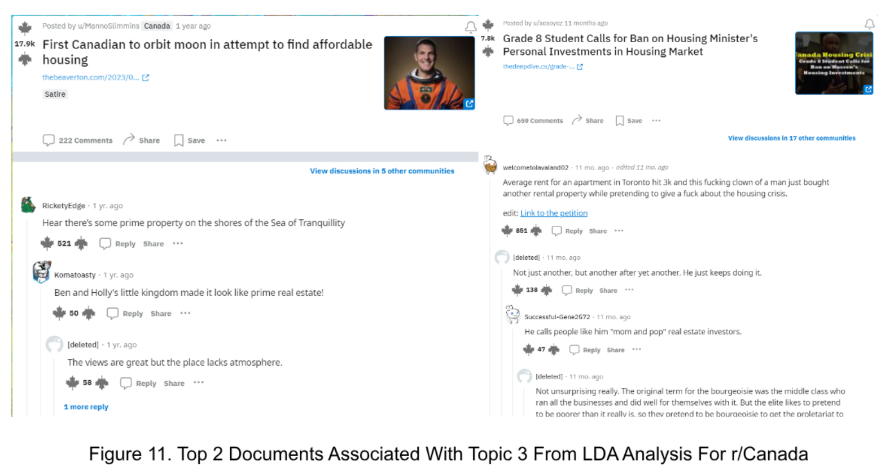
Final Results & What’s Next?
Notes:
Sentiment Analysis: Discussions on r/CanadaHousing and r/Canada are focused on housing affordability and market conditions. Most sentiments are negative, indicating dissatisfaction and concern.
Topic Modeling: Analysis revealed themes such as pricing, locations, types of housing, and government policies. These themes highlight the challenges related to housing affordability in Canada.
Research Question & Hypothesis: The study confirmed the hypothesis that social media discussions on housing costs in Canada are mostly negative, or at very least, people are aware and concerned over the issue.
Limitations: Social media data may not represent the entire Canadian population, and sentiment analysis techniques have limitations in capturing language nuances.
Implications & Future Research: The study informs political parties, researchers, and the public about housing affordability complexities in Canada. Future research could explore public opinion using a wider range of social media platforms and traditional survey methods.

Slide 7
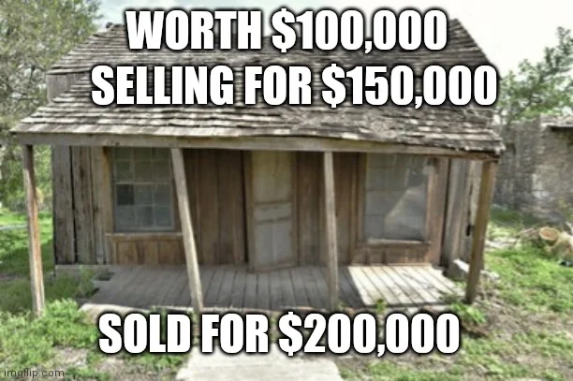
Thank You!

